Slide 1
Structural and Mechanical Properties of Polyelectrolyte Brushes
Takashi Yokokura
Advisor: Prof. Rui Wang
September 14th, 10:00 am – 12:00 pm
Qualifying Exam

Slide 2



Introduction
Polymer Brush
Chains end-fixed to some substrate
Steric interactions extend chains into solution
+
+
+
+
+
+
+
+
+
+
+
+
+
+
+
+
+
+
+
+
+
+
+
+
+
+
+
+
+
+
Polyelectrolyte Brush
Monomers contain charge
Long-range electrostatic interactions drive extension
+
+
+
+
+
+
+
+
+
+
+
+
+
+
+
+
+
+
+
+
+
+
+
+
+
+
+
+
+
+
+
+
+
+
+
Conformational possibilities
Coexistence between dilute, coil-like layer and condensed layer
+
+
+
+
+
+
+
Designable functionalized surface
Anti-fouling
“Smart” sensors
Cell-repellant Surface
Model system for biological aggregates
Axon stabilization through neurofilaments
(Chen, et al., Macromolecules, 2017 )
(Yuan, et. al., J. Cell Sci., 2012)

Slide 3




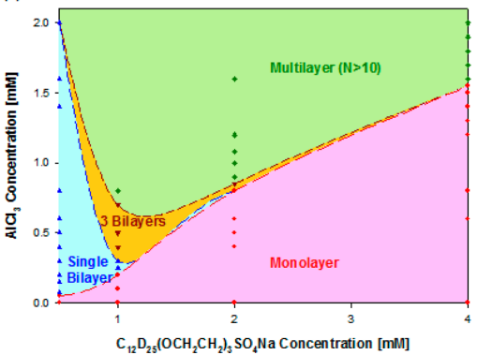

Previous Theories
Flory scaling – de Gennes, Alexander
Lattice-constrained Scheutjens-Fleer SCFT
Correlation length:
schematic
No. monomers in correlation blob:
Brush height:
(Rubinstein, Colby, Oxford Univ. Press, 2003)
Kuhn momomer length
None can consider effects from multivalent ions
Our theory:
Captures coupled response of elastic polymer to changing environment
Amenable to additional effects/interactions
Minimal approximations
1 mM Ba²⁺
1 mM Ca²⁺
0.1 mM Ca²⁺
0.01 mM Ca²⁺
6 mM Na⁺
(Xu et al., Langmuir, 2013)
(Yu et al., Science, 2018)

Slide 4

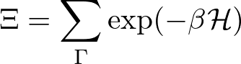
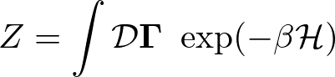






Outline
Model and Theory Development
111
111
Particle description
Field description
Self-consistent field theory

Slide 5
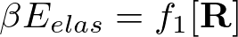

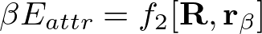


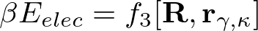



Model and Theory Development — System
What is the system made up of?
s
+
-
Interactions:
Elasticity (monomer-monomer)
Solubility (solvent-monomer)
Electrostatics (ion-monomer)
Polymer curve
+
-
s
+
s
s
s
-
+
+
+
+
+
+
+
-
+
s
Discrete particle locations
+
s
+
-
s
+
-
s
s
+
+
s

Slide 6










Model and Theory Development— Interactions
Elastic entropy following Gaussian statistics
Flory-Huggins short-range interactions
Electrostatic correlations over Coulomb operator
Local incompressibility
Semicanonical Ensemble

Slide 7
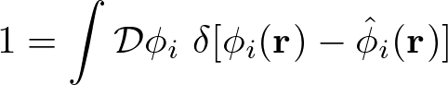
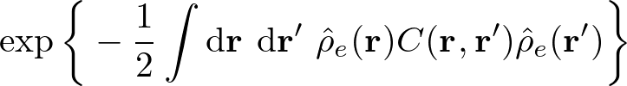
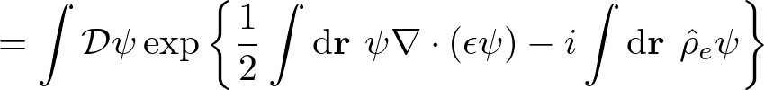

Model and Theory Development— Interactions
Particle-to-Field Transformation
111
Hubbard-Stratonovich Transformation
111
Saddle-point approximation

Slide 8














Model and Theory Development — SCF Eqns
Free Energy (ensemble average across surface)
Functional Minimization
Polymer Density:
Polymer-controlling Field:
Solvent Density:
Solvent-controlling Field:
Incompressibility:
Monomer Probability:
Electrostatic Potential:

Slide 9
Outline
Model and Theory Development
Systematic Study (VdW Attraction vs. Electrostatic Repulsion)
s
s
s
s
s
s
s
+
+
+
s
+
+
+
+
+
+
+
s
Hydrophobicity
(VdW attraction)
s
s
s
Attractive
Repulsive
Experimental Characterization (Reflectivity)
Experimental Application (Neurofilament-Heavy)
Future Work
Polymer charge fraction
(Electrostatic repulsion)

Slide 10







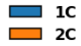

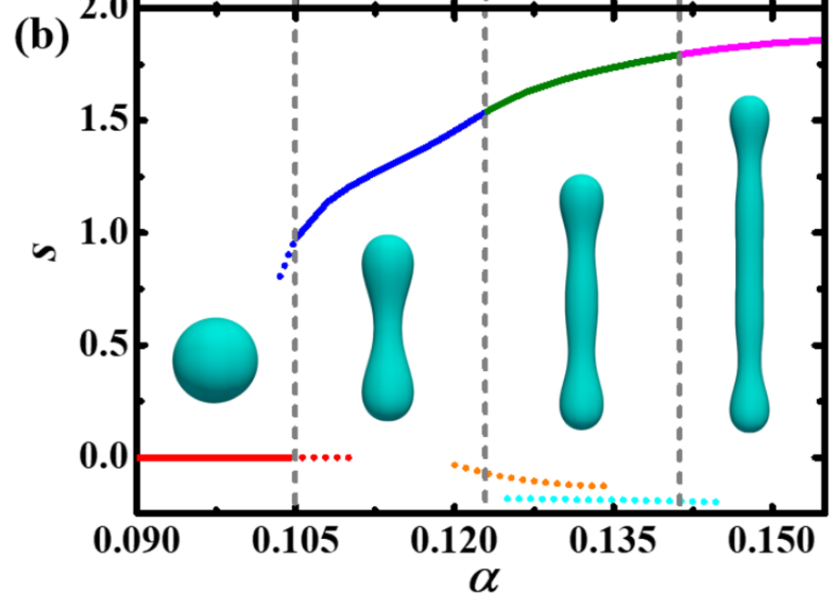



Varying VdW ($χ$) at const. Electrostatic ($α=0.40$)
System:
Height
C = “condensed” layer(s)
Polymer density profiles
(nm)
Similar “multi-layered” structures found in dilute polyelectrolyte solutions
Repulsion promotes segregation, while hydrophobicity and elasticity promote condensation
1 condensed layer
1 condensed layer
2 condensed layers
3 condensed layers
4 condensed layers + 1 dilute layer
0
0
(Duan and Wang, JCP, 2020)
0
Polymer distribution
Polymer smeared charge
Flory-Huggins parameter
Free energy
2 condensed layers

Slide 11


Varying VdW and Smeared Charge Fraction
System:
C = “condensed” layer(s)
Higher polymer charge leads to richer conformational space
(nm)
Coexistence with dilute layer adjacent to the dilute regime
Repulsion
As attraction becomes dominant, brushes insensitive to charge
Attraction
Polymer distribution
Polymer smeared charge
Flory-Huggins parameter

Slide 12



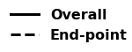

Chain Architecture of Multi-peaked Conformations
Two candidates with identical averaged density profiles
2 condensed
Chains stay within one layer, regardless if condensed or dilute
4 condensed + 1 dilute
“Locked-in-layer”
“Pearl-necklace-like”
(Endpoint densities x 30)

Slide 13

Outline
Model and Theory Development
Systematic Study (Solubility vs. Internal Charge)
Internal Structure of xC
Reflectivity Spectra for Multi-peak conformations
Experimental Application (Neurofilament-Heavy)
Cooperative Collapse of the Dilute Layer
Future Work

Slide 14





Reflectivity
Reflectivity provides characterization of vertically stacked films (layers)
However, polymer density profiles are not generated, but guessed
Specular wave scattering vector
Master Equation:
(Schreiber, n.d.)
(Reinhardt, et. al. Macromolecules, 2013)

Slide 15

Outline
Model and Theory Development
Systematic Study (Solubility vs. Internal Charge)
Internal Structure of xC
Reflectivity Spectra for Multi-peak conformations
Application of Theory to Neurofilament-Heavy Protein Brush
“… AQGEEEEEAEEGGEEAATTSPPA …”
(Srinivasan, 2014)
“Heavy”
(Yuan, 2012)
Future Work

Slide 16




Method of Coarse-graining Protein Charge Distribution
A straight-forward method is to monitor the cumulative sum (cusum) of the charge distribution
Sample sequence:
HHHHHHHHHHHHHHH DDDDDDDDDDDDDDDDDDDDDDDDDDDDDD KDDDHHK KDDDHHK KDDDHHK KDDDHHK KDDDHHK KDDDHHK KDDDHHK KDDDHHK KDDDHHK KDDDHHK

Slide 17



Application to NFH, pH 2.4
Merge with previous

Slide 18



Cooperative Collapse of the Dilute Phase
What changes are occurring within NFH during 3x decrease?
Dramatic collapse
2Cd
2C
1C
“Cooperative collapse”
Too many
Summary line

Slide 19
Summary
We have derived a SCFT considering the coupling of polymer elasticity, Flory-Huggins interactions, electrostatics, and local incompressibility. Using this theory, we have concluded the following:
Multi-peaked conformations form to locally balance competing interactions.
These conformations are exclusive to polyelectrolyte brushes.
Characteristic reflectivity spectra should serve to validate our results experimentally
Cooperative interactions in NFH between ionic strength and effective grafting density caused a 3x decrease in height.
Each chain is allowed in only one layer. Outer layers are “grafted” upon inner layers.

Slide 20
Outline
SCFT Build-up
Systematic Study (Solubility vs. Internal Charge)
Internal Structure of xC
Experimental Characterization (Reflectivity)
Experimental Application (Neurofilament-Heavy)
Cooperative Collapse of the Dilute Layer
Future Work

Slide 21
Future Work
xC extension:
Response to foreign species (e.g. spherical tip of AFM)
Response to brush-brush
Multivalent ions (ion correlations)
Experimental Collaborations
Validation with reflectivity
NF(L/M/H) blends for study of biological neurofilaments
Erika Ding, Prof. Sanjay Kumar
Nafion aggregation using SCFT-generated force fields and MD
Siddarth Rajupet, Prof. Clayton Radke
Much more specific; physics /interactions of each problem
Highlight difficult problem and not that it’s a collaboration
What is your planned contribution

Slide 22






Acknowledgements
Wang Group
Prof. Rui Wang
Dr. Chao Fang
Luofu Liu
Nikhil Agrawal
Dr. Chao Duan

Slide 23
Summary
Paste from above when finished

Slide 24
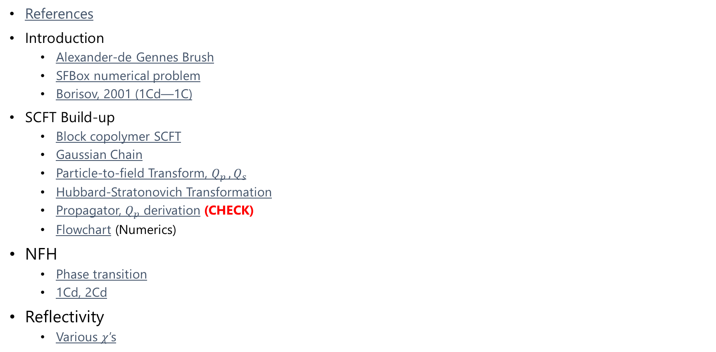
SI: Table of Contents
References
Introduction
Alexander-de Gennes Brush
SFBox numerical problem
Borisov, 2001 (1Cd—1C)
SCFT Build-up
Block copolymer SCFT
Gaussian Chain
Particle-to-field Transform, $Q_{p }, Q_{s}$
Hubbard-Stratonovich Transformation
Propagator, $Q_{p}$ derivation (CHECK)
Flowchart (Numerics)
NFH
Phase transition
1Cd, 2Cd
Reflectivity
Various $χ$’s

Slide 25
References
Abnormal NF image: Yuan, A., Rao, M. V., Veeranna, & Nixon, R. A. (2012). Neurofilaments at a glance. Journal of Cell Science, 125(14), 3257–3263. https://doi.org/10.1242/jcs.104729
Height Profile Figure: Srinivasan, N., Bhagawati, M., Ananthanarayanan, B., & Kumar, S. (2014). Stimuli-sensitive intrinsically disordered protein brushes. Nature Communications, 5(1), 5145. https://doi.org/10.1038/ncomms6145
Alexander-de Gennes Brush: Rubinstein, M., & Colby, R. H. (2003). Polymer Physics, Oxford University Press. New York.
Lubricity Figure: Yu, J., Jackson, N. E., Xu, X., Morgenstern, Y., Kaufman, Y., Ruths, M., de Pablo, J. J., & Tirrell, M. (2018). Multivalent counterions diminish the lubricity of polyelectrolyte brushes. Science, 360(6396), 1434–1438. https://doi.org/10.1126/science.aar5877
XR Multilayer Figure: Xu, H., Penfold, J., Thomas, R. K., Petkov, J. T., Tucker, I., & Webster, J. P. R. (2013). The Formation of Surface Multilayers at the Air–Water Interface from Sodium Polyethylene Glycol Monoalkyl Ether Sulfate/AlCl ₃ Solutions: The Role of the Size of the Polyethylene Oxide Group. Langmuir, 29(37), 11656–11666. https://doi.org/10.1021/la4030348
Anti-Biofouling Figure: Chen, W.-L., Cordero, R., Tran, H., & Ober, C. K. (2017). 50th Anniversary Perspective: Polymer Brushes: Novel Surfaces for Future Materials. Macromolecules, 50(11), 4089–4113. https://doi.org/10.1021/acs.macromol.7b00450
XR Layout Figure: Schreiber, F., & Gerlach, A. (n.d.). X-Ray and Neutron Reflectivity. Department of Chemistry - University of Oxford. www.physchem.ox.ac.uk/~fs
XR Spectra Figure: Reinhardt, M., Dzubiella, J., Trapp, M., Gutfreund, P., Kreuzer, M., Gröschel, A. H., Müller, A. H. E., Ballauff, M., & Steitz, R. (2013). Fine-Tuning the Structure of Stimuli-Responsive Polymer Films by Hydrostatic Pressure and Temperature. Macromolecules, 46(16), 6541–6547. https://doi.org/10.1021/ma400962p

Slide 26




Alexander-de Gennes Brush
Monomers in correlation blobs (self-avoiding walk)
Height = Correlation length x No. Correlation blobs
“Correlation length”
Rubinstein, M., & Colby, R. H. (2003). Chapter 5.3

Slide 27


Borisov previous theory
Klushin, Birshtein, Amoskov. (2001). Macromolecules, 34.

Slide 28

SFBox Lattice Artifacts
Pryamitsyn, V. A., Leermakers, F. A. M., Fleer, G. J., & Zhulina, E. B. (1996). Macromolecules, 29(25), 8260–8270.

Slide 29




Block copolymer Free Energy, SCF Eqns
Variational Free Energy
After statistical average over grafting surface (x-y plane)
Functional Minimization
SCF Equations

Slide 30


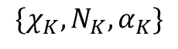
Block copolymer PDEs
Mean-field Poisson-Boltzmann Equation
Modified Diffusion Equation
Block K
$$\{χ_{K},N_{K}, α_{K}\}$$
Block 2
Block 1

Slide 31





SCFT Build-up — Flowchart
PDE Solve (for iteration k)
Propagate (using PDE solutions)
Check (for self-consistency)
Update (if not satisfied)
Anderson Mixing
Simple Mixing
Notation slightly incorrect but changed for clarity. w^{k} = f(w^{k+1/2}, w^{k-1}), where w^{k+1/2} is from SCFT calculations (\phi remains ^{k})

Slide 32











Gaussian Chain
Probability of R with N
Bond vector distribution
Local Fluctuation
Generalize to whole chain with free internal segments
Large N, kb << 1
Configurational integral with free ends

Slide 33



Particle-to-Field Transform

Slide 34
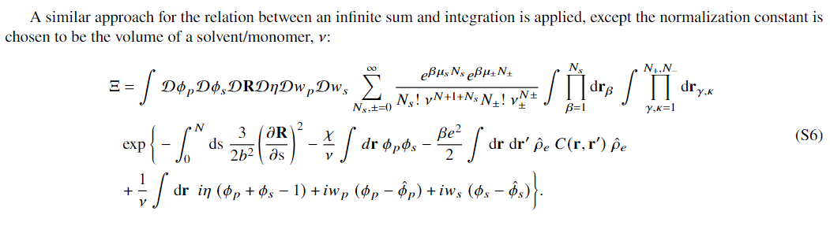


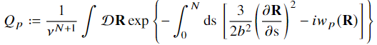
Particle-to-Field Transform (2)
Cancels out

Slide 35
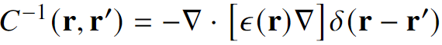
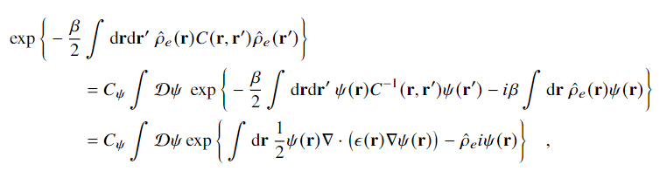
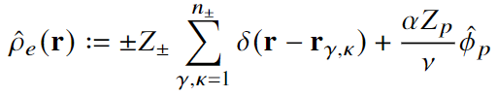
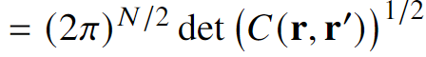
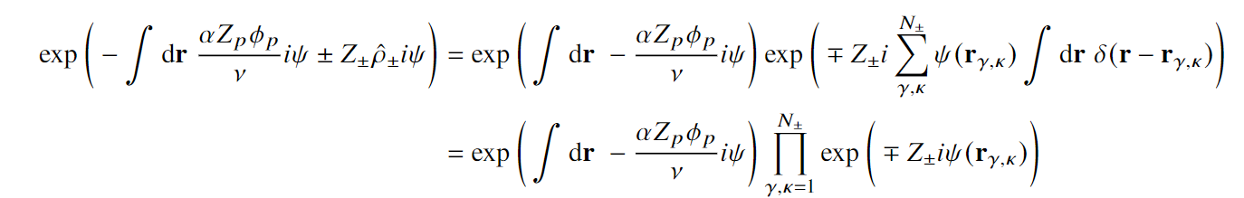
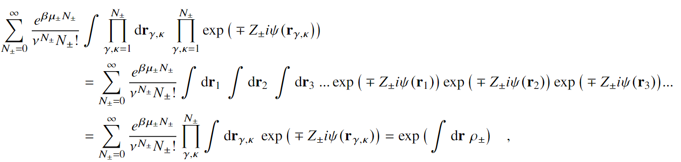
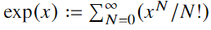
Hubbard-Stratonovich Transformation
Constant, ignored
Electrolyte GCE

Slide 36




Propagator notation

Slide 37


Varying VdW ($χ$) at const. Electrostatic ($α=0.40$)
System:
Polymer distribution
Polymer smeared charge
Flory-Huggins parameter
Free energy

Slide 38


Reflectivity — Different $χ$’s

Slide 39

NFH Phase Transition

Slide 40

NFH 1Cd, 2Cd

